Slide 1

SWR302 ASSIGNMENT 1.2
SE1619-NET _ Group 4
Lecture: Chu Thi Minh Hue

Slide 2

mEMBERS

Slide 3
Members
Nguyễn Hữu Tiến Anh (Leader)
Đặng Tất Thành
Đan Công Duy
Nguyễn Minh Đức
Thái Minh Quang

Slide 4
Task of each member
Nguyễn Hữu Tiến Anh:
Record of change
Product vision
Business Rules
UC-01 User detail

Slide 5
Task of each member
Đặng Tất Thành:
Actor list
Assumptions & Dependencies
Business Rules
UC-02 Class detail

Slide 6
Task of each member
Nguyễn Minh Đức:
Limitation and Exclusions
Business Rules
UC-03 Subject detail

Slide 7
Task of each member
Đan Công Duy:
Major features
Business Rules
UC-04 Team detail

Slide 8
Task of each member
Thái Minh Quang:
Product context
Uses case
Business Rules
UC-05 Iteration detail

Slide 9

Present detail
Alll of the works our team have done

Slide 10

Product vision
Student Project Management - a system for managing projects of subjects. In this system, students will be able to track their project progress along with the evaluation and comments of the lecturer. As for teachers, they will be able to manage student projects more easily, as well as easily give timely evaluation comments to students who complete the project. And the important part is indispensable to manage the score and course status (pass or not pass).

Slide 11
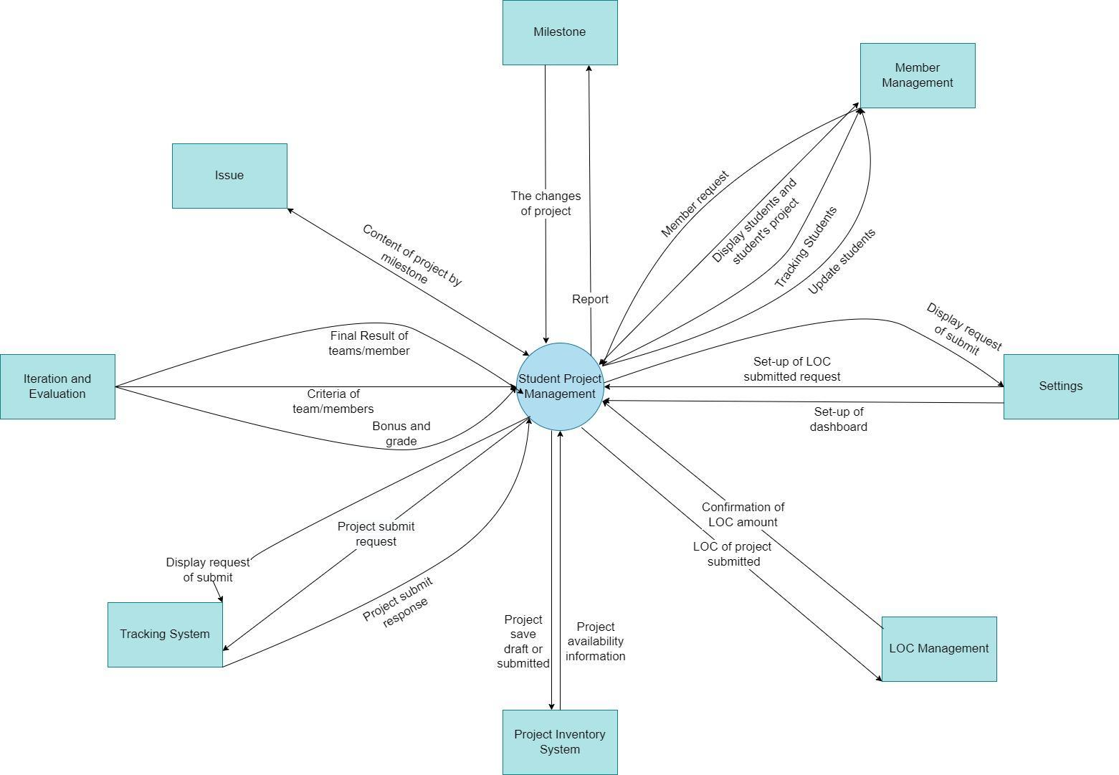
Product context

Slide 12
Major feature
FE-01: home and dashboard.
FE-02: login, register.
FE-03: setting list, setting detail.
FE-04: user profile, comment, manage LOC.
FE-05: edit user profile, create content for students.
FE-06: push file on system, view score of student.

Slide 13
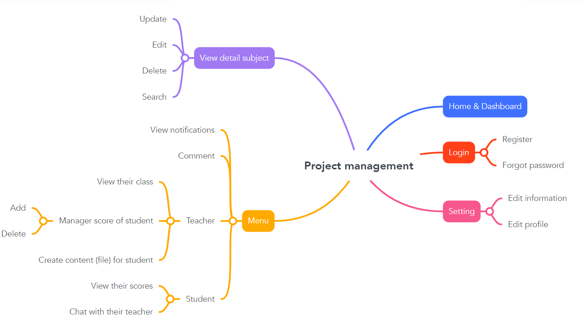
Mind map

Slide 14
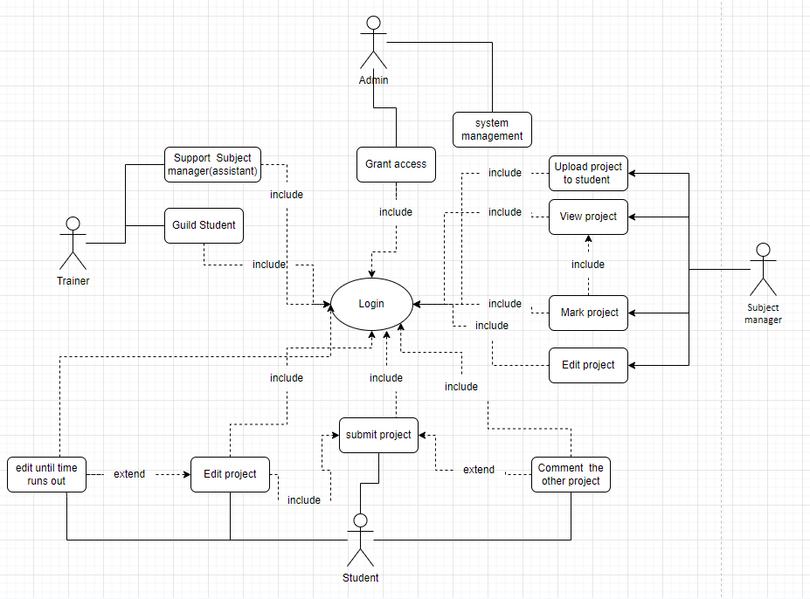
Uses case

Slide 15
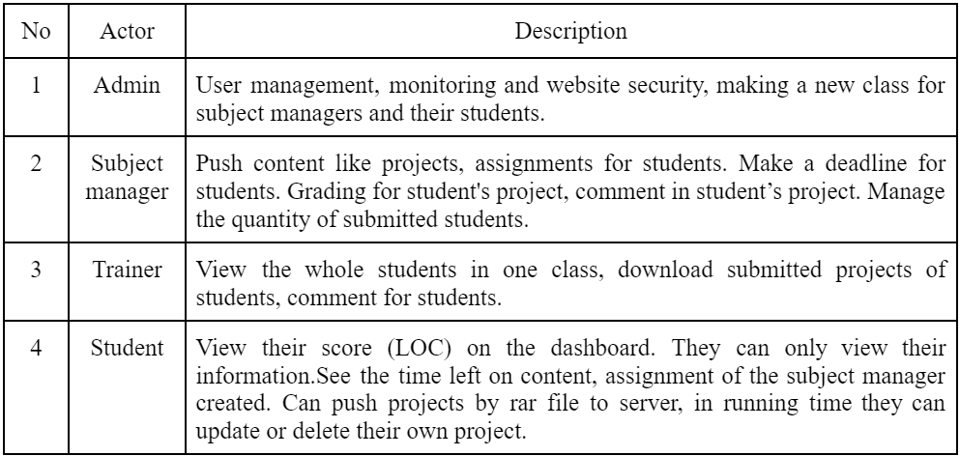
Actor list

Slide 16
Assumptions & Dependencies
Users as role students can upload files to submit projects for lecture to grade and comment.
Teachers can create deadlines for students, after the required time students can’t do any work on this process.

Slide 17
Limitations and Exclusions
Users may require a real-time system counting down from the website.
Users may require a larger file than file can accept.
Users may need to rename a file or a note for their project.

Slide 18
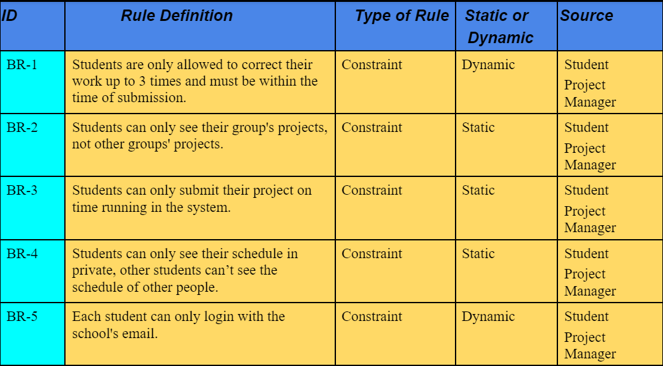
Business Rules

Slide 19
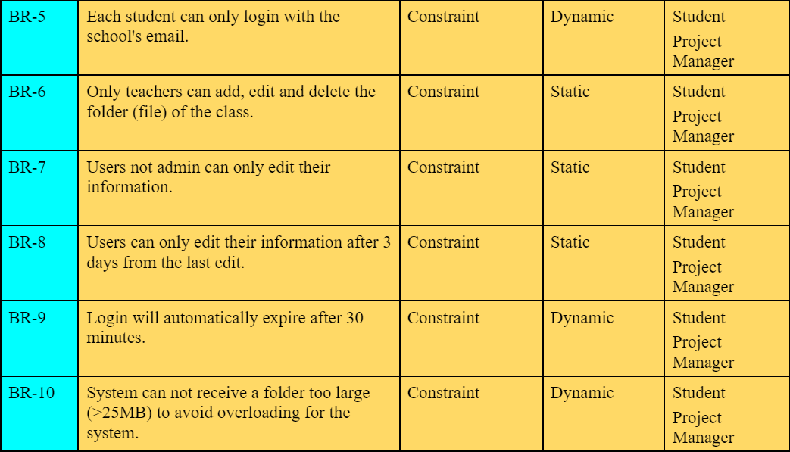
Business Rules (1)

Slide 20
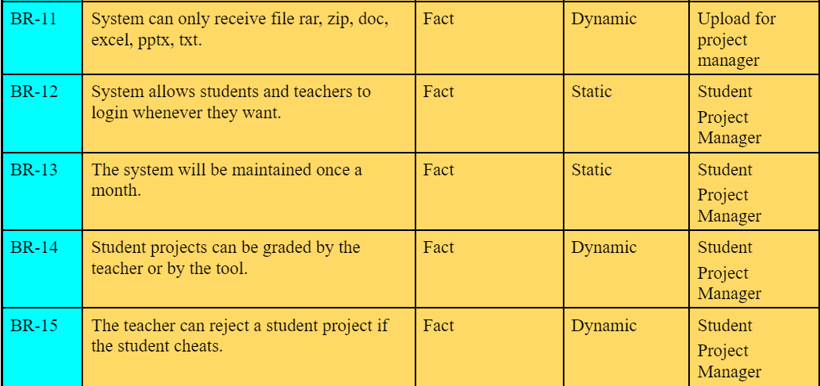
Business Rules (2)

Slide 21
Use Case Specifications
User detail feature
Class detail feature
Subject detail feature
Team detail feature
Iteration detail feature

Slide 22
THANKS FOR WATCHING

